Slide 1
Qtechit’s
Business
Profile &
Service Offers

Slide 2
Agenda
Introduction
Recent & Upcoming Products
Our Approach
Technologies & Service
Team Overview
Benefits of Services
Development Process
Project Management & Reporting
Advantage & Disadvantage
Getting Stated
Contact Info

Slide 3

NAVIGATE THE FUTURE
Let's Grow Together

Slide 4
Who we are?
Qtech IT, a software and web / app development company committed to delivering innovative digital solutions tailored to meet the unique needs of businesses across various industries. We have evolved into a trusted partner for organizations looking to enhance their online presence, streamline operations, and leverage technology to drive growth.
Integrity is fundamental to our business practices. We are committed to being honest, transparent, and ethical in all our dealings. Our clients can trust us to deliver on our promises, and we strive to build long-lasting relationships based on mutual respect and accountability.

Slide 5

Exploring New Frontiers
Market
expansion

Slide 6
New PRODUCT Launching
Qhub360 – AI Workforce Manager
Launched At 01/02/25
AI based staff scheduling
Time check-in, Holiday, Vacation
Pay slip, Invoice generation
Easy, modern UI & UX
SaaS model implements
www.qhub360.com
Qhub360
Business Dashboard
HR & Accounts
Qhub360
Payroll
Qhub360
Android & IOS
Qhub360

Slide 7
Currently Working
Qcentraa – PMS SYSTEM
FixByte Repair Management Platform
Theme for Codecanyon (Inhouse)

Slide 8
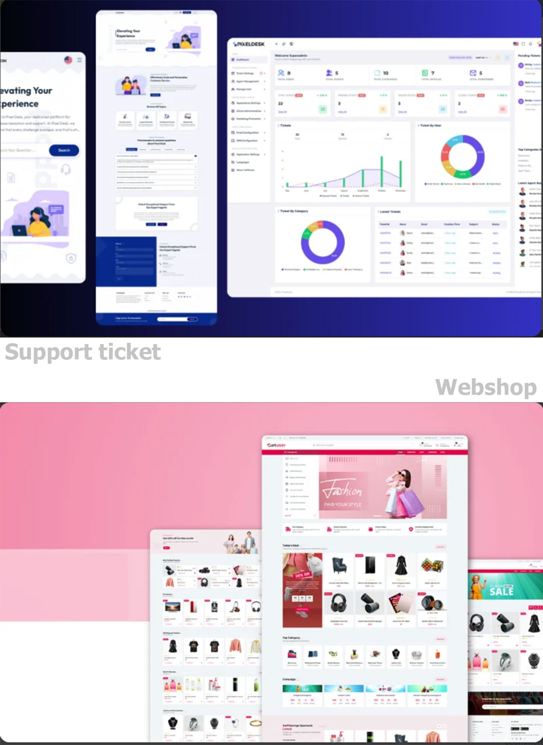
Already in market
Introducing the system, the next-generation AI-powered Support Ticket System designed for seamless and intuitive customer support management.
Technology :
PHP
React JS
Flutter 3.x
Complete eCommerce Mobile App, Web, Admin Panel, Seller/Vendor Web & App, Delivery man App
Technology :
Laravel
PHP
Next JS
Flutter 3.x

Slide 9
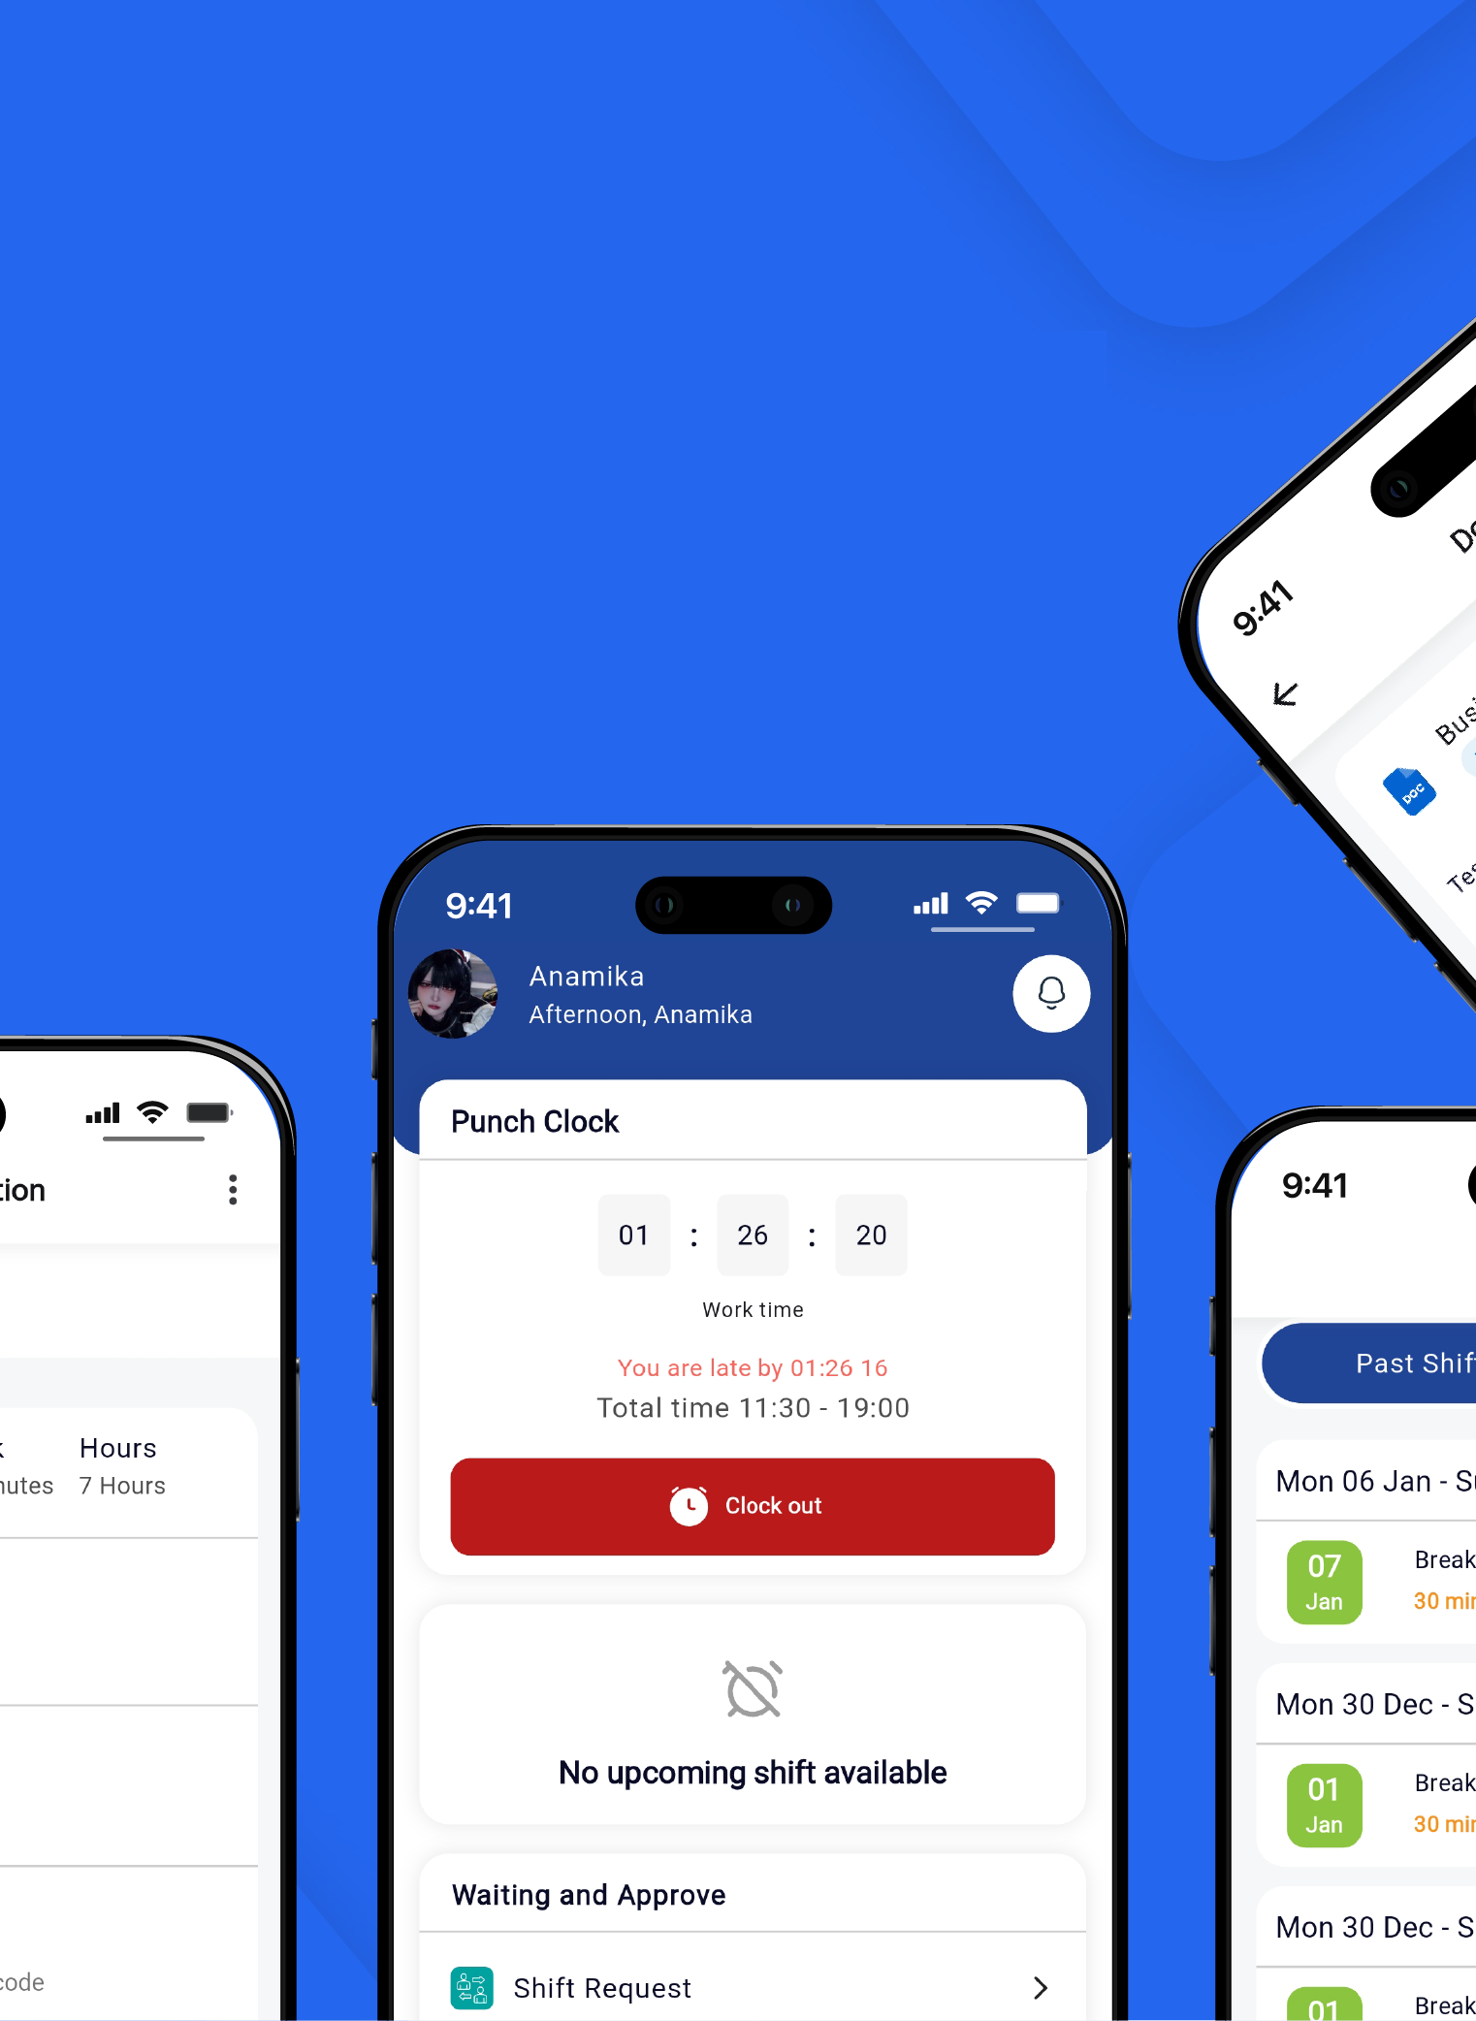
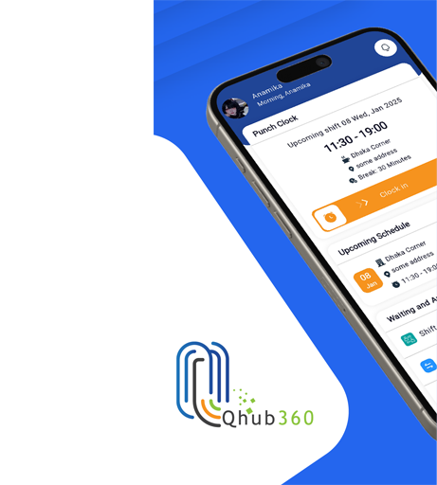
Already in market
Used the power of AI, Full control over your employee to manage & assigning shift, task.
Technology :
Laravel 11
Next Js
Flutter 3.x

Slide 10
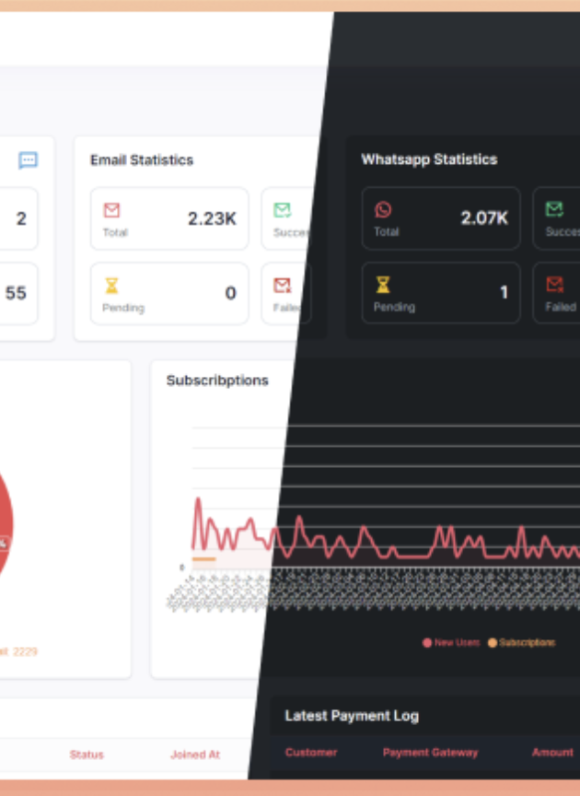
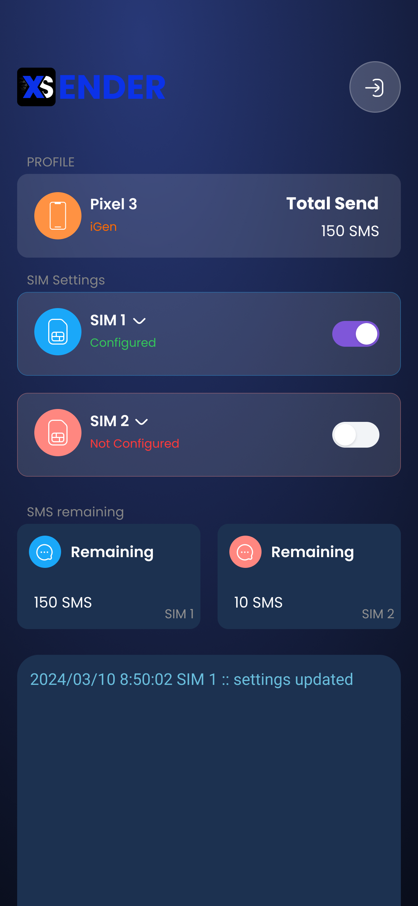
Already in market
Sender - Complete Mass Message marketing system via Email, SMS, WhatsApp Message with marketing automation
Sender – Android SMS Gateway which is reduce cost for the text message sending without any SMS API provider using SIM card, any organization and individual business holder can use for their marketing and promotional purpose.
Technology:
Laravel
PHP
Next JS
Flutter 3.x
Node JS

Slide 11
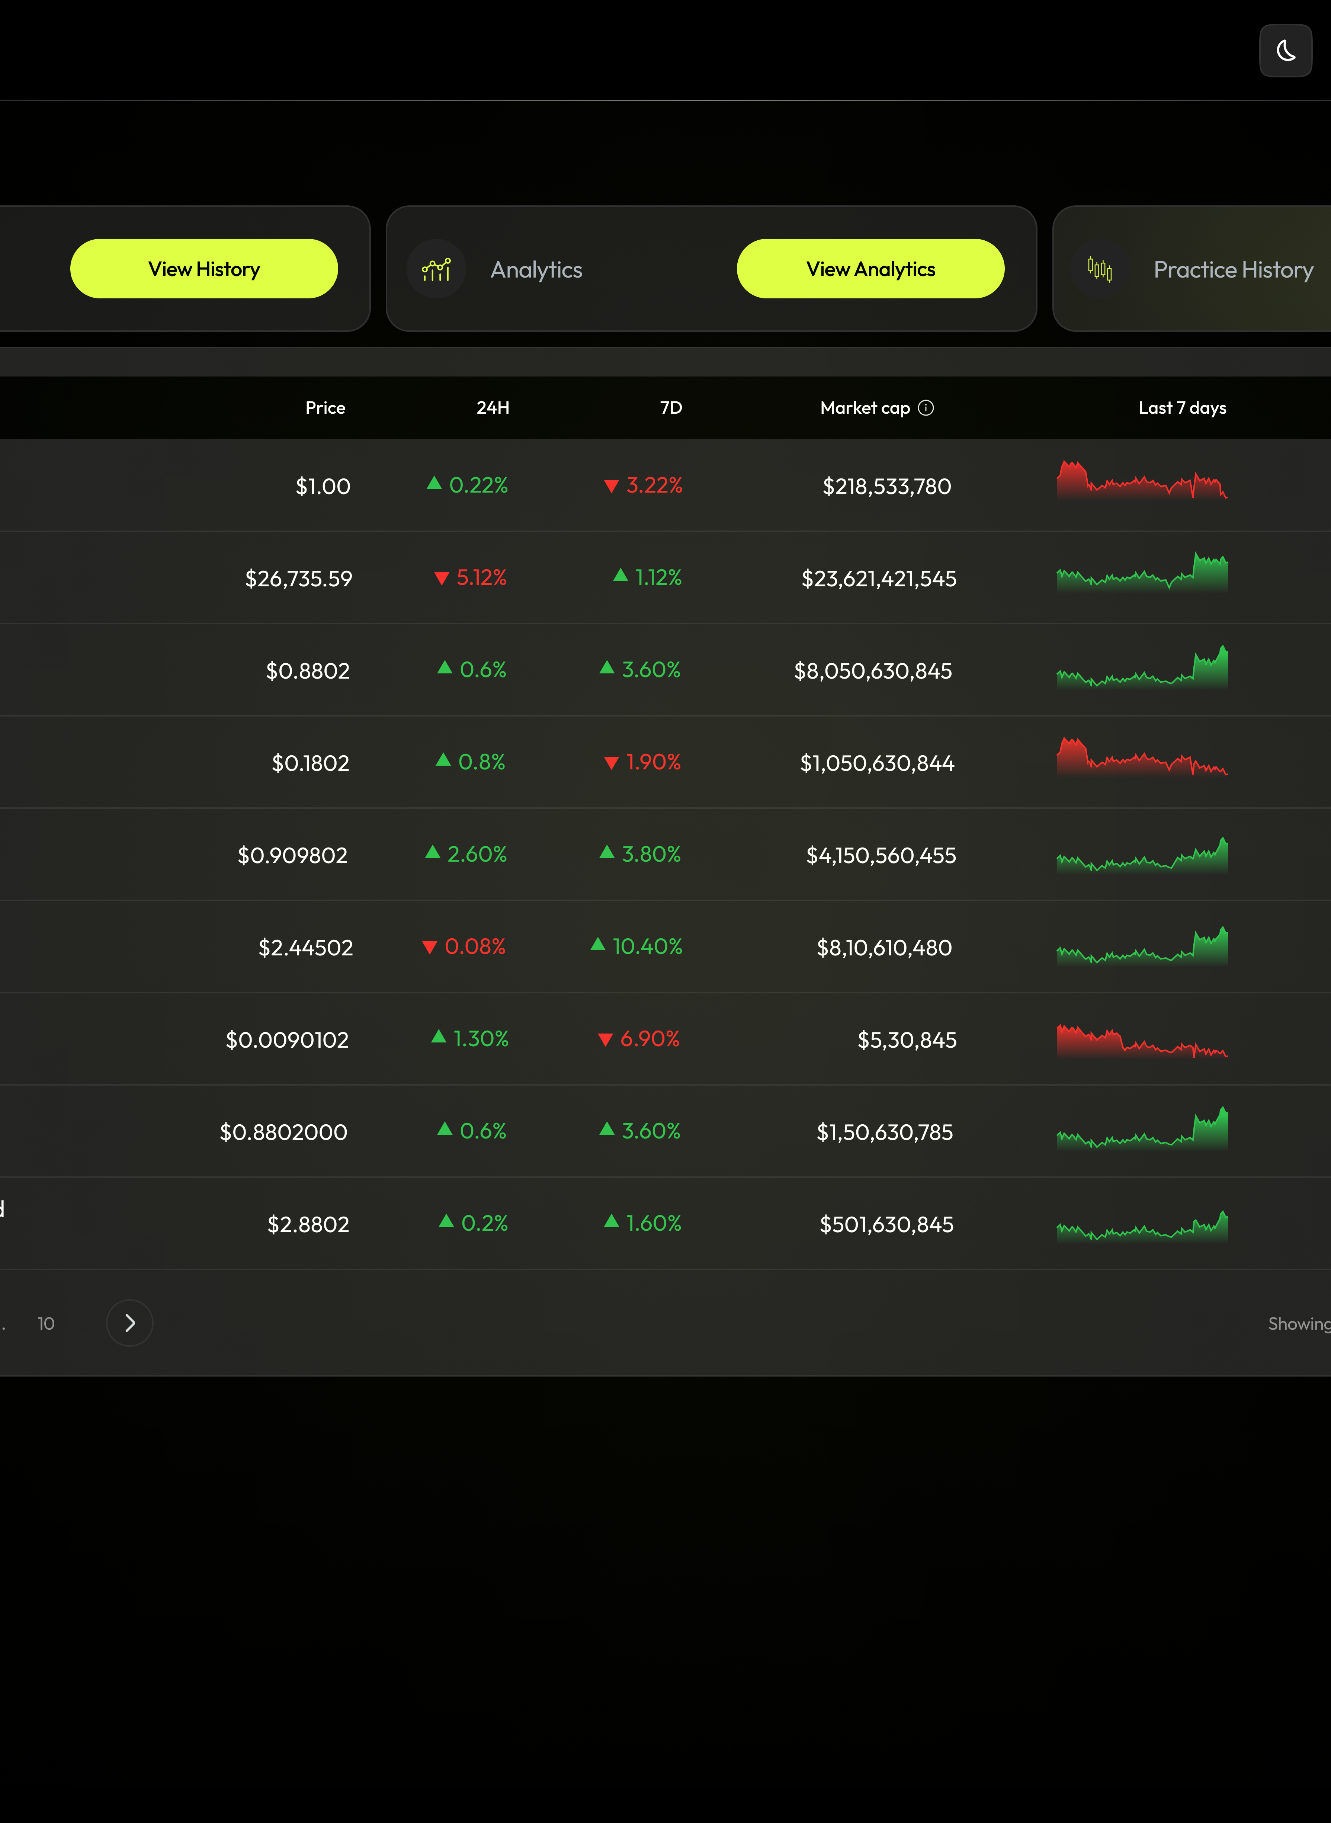
Already in market
Fin Funder – Blockchain technology crypto trading platform which is completely automation and market analysis and P2P trading platform by various exchanger
Technology:
Laravel
PHP
Next JS
Flutter 3.x
Node JS

Slide 12
Our approach
We can provide a dedicated talent to assist with your current vacancy on a monthly basis, working remotely. They will collaborate with your team, follow the task list, complete assignments, and upload the finished work to your server or GitHub.
We provide professional software, web & mobile development services, supported by a comprehensive Service Level Agreement (SLA).
We will adhere to your company’s policies, including those related to vacations, weekends, and work schedules.
Data protection in compliance with GDPR –Europe will be followed
We will adapt to any development methodologies and tools utilized by your company like – Scrum, Git, Jira etc.
We will not include your project in our portfolio & not take any advantage by your client.
QtechIT is a registered company in the Netherlands, operating in full compliance with all applicable laws and regulations governing software development businesses.
We ensure adherence to legal standards, including data protection, intellectual property rights, and other statutory requirements, to maintain the highest level of integrity and professionalism in our operations.

Slide 13
Technologies & Services
Technology
Frontend Developer – HTML, CSS, Tailwind, JavaScript, React, Angular, Vue, Next, Node JS.
Backend Developer - PHP, Laravel, WordPress, Python, Java, C#, ASP .NET, GO, API Dev.
Mobile Applications – Kotlin, Dart / Flutter, Swift, Objective – C, React Native.
Inclusive – GitHub, Jira, Slug, Diagrams, Scrum, Agile, Figma etc.
Full-Stack Developments
Complete project starting with Requirements Analysis -> Mosco -> Diagrams->Prototyping
->Developments->Testing & Debugging->Server Conf. & Upload->Final Report & Manual.
DevOps & QA Support
Cloud Services & Management, CI & CD, Manual, Automated, Performance, Security, Unit Testing etc.
UI & UX Support
Website, Mobile App UI/UX, Completive Analysis, User Research & Persona Etc.

Slide 14
Development Team Overview
Local Team (Netherlands)
1 Support Engineer
1 DevOps Engineer
2 Full Stack Developers
Remote Team (Dhaka, Bangladesh)
1 CTO
1 Project Manager
2 Full Stack Developers
3 Front-End Developers
2 UI/UX Designers
2 Mobile App Developers
1 Q/A Tester
1 SEO & Content Writer

Slide 15
Benefits Of Service
Problem | Solutions
Employee is not skilled enough to handle all the requirements professionally. | Our talents are highly skilled and stay up-to-date with the latest cutting-edge technology.
Hiring a professional would incur high monthly salaries and employee benefits. | 25% or more monthly salaries saving. No employee benefits extra calculations.
Unavailability and limited reporting tendency | Our QA will follow up & handle all those run-time issue.
There is no backup person who can handle remaining task. | The task will be monitored by the CTO and LEAD dev. Proper reporting & communication is guaranteed.
Our team is limited to any specific technology. | We can promptly manage all types of requirements “web, desktop, mobile apps”

Slide 16
Process
Understand the Requirements
He will go through all your current development & understand work flow.
Collaboration
He will start collaborating with your team through meetings, discussions, and regular progress reports.
Contributing daily
He will actively contribute as a key member of your team, assisting in the development of your website or mobile application.
Deployment and Launch
He will be a valuable asset during product launch, ensuring a smooth and seamless process with his expertise and support.

Slide 17
Project Management & Reporting
Regular Progress Updates
Transparent Communication
On-Time Delivery Guarantee
We keep you informed about the progress of your projects through regular updates.
Our team maintains open and clear communication throughout the development process.
We commit to delivering your projects on time as agreed in the project timeline.

Slide 18
Potential Disadvantage
Topic | Comments
Language | We have only four persons speak Dutch, Others communicate in English.
Requirements Clarify | Sometimes, It may be more convenient to share a drawing or send a video.
Described By Diagram | For complex functionality you may need to provide Use case, ERD, or Class Diagram to requirements engineering.

Slide 19

Explore Innovative solutions
Ready to get started?
We welcome your expert suggestions and look forward to collaborating for the best possible outcome.
Email - info@qtechit.dev

Slide 20
Thank you
Qtech IT
The Netherlands registered it company
Rietdekkerstraat 24, 1445 KG Purmerend, Netherlands
www.qtechit.dev | info@qtechit.dev
+31 06 34594235
KvK – 95630023
Submitted by
Ahasanul Rabbi Khan
Data & Program Lead
Qtech IT
+31 0684611580
ahasan@qtechit.dev
www.qtechit.dev

